Slide 1

ExEEd- ACADEMIC SUCCESS
Traffic Control System
S.NO | Name | Roll No. | Branch & Section
1 | B. Sai Teja | 20951A1286 | IT-A
2 | B. Sagar Naik | 20951A1281 | IT-A

Slide 2
Aim & Objective
Density-based traffic control systems are intelligent transportation systems that utilize advanced technologies to manage and optimize traffic flow on road networks.
These systems employ sensors, data analysis, and real-time monitoring to dynamically adjust signal timings at intersections based on the density of vehicles present.
The primary goal of density-based traffic control systems is to reduce congestion, minimize delays, and improve overall traffic efficiency.
Traditional traffic control systems operate on fixed signal timings, regardless of the actual traffic conditions.
Density-based traffic control systems typically employ advanced algorithms and optimization techniques to compute the optimal signal timings.
These algorithms consider factors such as traffic volume, vehicle arrival patterns, historical data, and network-wide coordination to generate efficient signal plans.

Slide 3
Problem Definition
As the problem of urban traffic congestion intensifies, there is a pressing need for the introduction of advanced technology and equipment to improve the state-of-theart of traffic control.
The current methods used such as timers or human control are proved to be inferior to alleviate this crisis. In this paper, a system to control the traffic by measuring the realtime vehicle density using canny edge detection with digital image processing is proposed.
This imposing traffic control system offers significant improvement in response time, vehicle management, automation, reliability and overall efficiency over the existing systems.
Besides that, the complete technique from image acquisition to edge detection and finally green signal allotment using four sample images of different traffic conditions is illustrated with proper schematics and the final results are verified by hardware implementation.

Slide 4
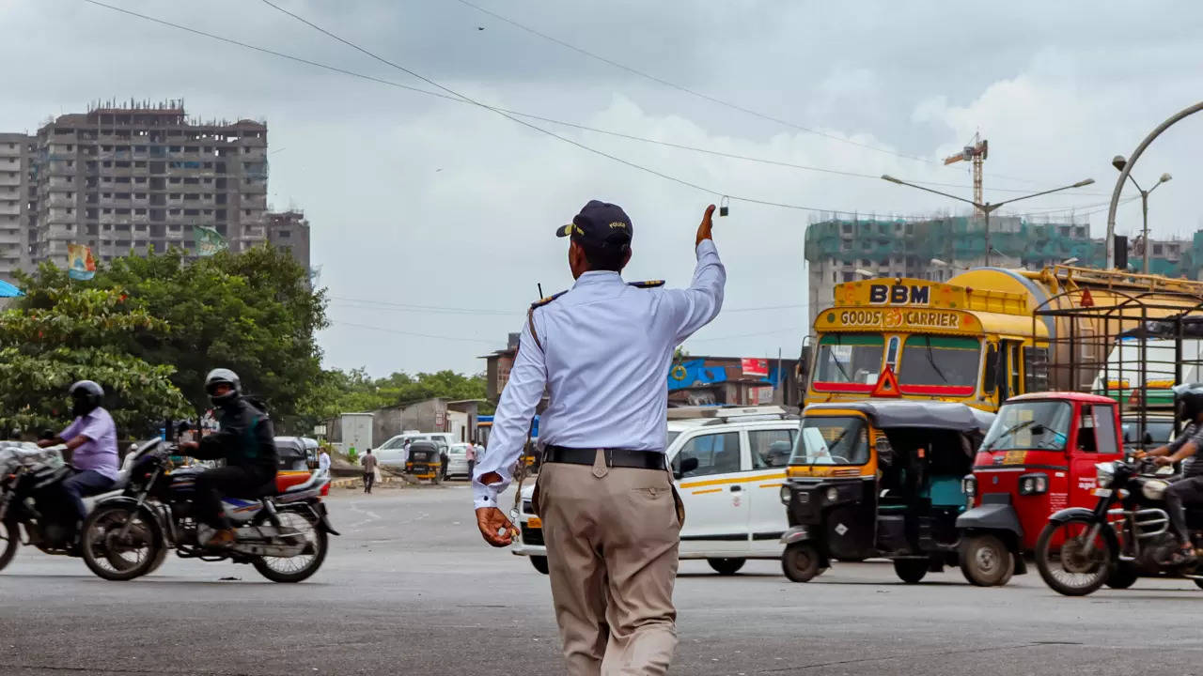
Traffic Prediction: ML models can analyze historical traffic data, weather conditions, and other factors to predict future traffic patterns. These predictions can help optimize signal timing. Intelligent Traffic Signal Control: ML algorithms can optimize traffic signal timings based on real-time traffic data. By continuously monitoring traffic conditions and adjusting signal timings accordingly. Traffic Incident Detection: ML algorithms can analyze live video feeds from traffic cameras to detect and classify various traffic incidents such as accidents, road hazards, or vehicle breakdowns.
Background of Idea (Who is it for?)

Slide 5
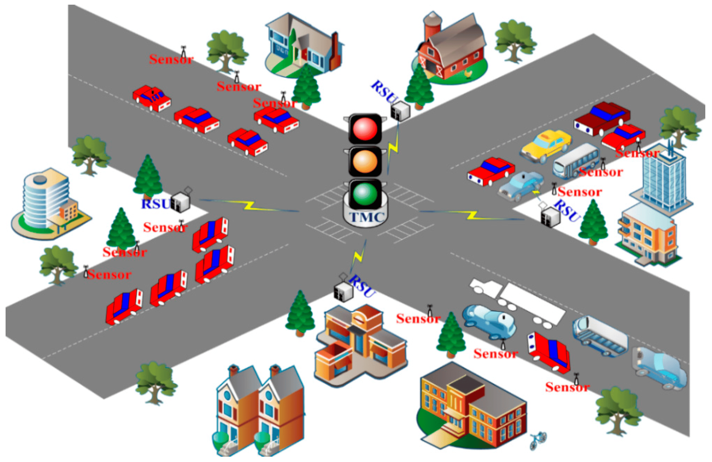
Adaptive Traffic Routing: ML models can analyze real-time traffic data, including current traffic volumes, congestion levels, and road conditions.
Background of Idea (Who is it for?)

Slide 6
Background of Idea (What will it do?)
Data Collection: Use video cameras or sensors to capture live traffic footage at intersections.
Pre-processing: Apply the Canny edge detection algorithm to identify vehicle edges and reduce image noise.
Feature Extraction: Extract relevant features from the detected edges, such as vehicle count, sizes, and positions.
Data Labeling: Manually label the extracted features with corresponding traffic density levels (e.g., low, medium, high).
Machine Learning Model Training: Train a machine learning model using the labeled data to predict traffic density based on the extracted features.
Real-time Traffic Monitoring: Continuously analyze live traffic footage in real-time using the trained model.
Signal Timing Adjustment: Dynamically adjust signal timings based on predicted traffic density to optimize traffic flow.

Slide 7
Background of Idea (Unique Features)
Real-Time Traffic Monitoring: A unique feature of a traffic control system can be the ability to monitor and analyze traffic conditions in real-time. By integrating sensors, cameras.
Machine Learning Algorithms: Incorporating machine learning algorithms allows the system to continuously learn and adapt to changing traffic patterns. We are using Canny Edge detection Algorithm to analyze the signal timings.

Slide 8
Background of Idea (Unique Features)
Smart Intersection Management: Advanced intersection management features can be a unique aspect of a traffic control system. This includes utilizing sensors, cameras, and algorithms to optimize signal timings, coordinate signal phasing for multiple intersections, and prioritize different traffic flows based on demand and congestion levels. These features can significantly improve intersection efficiency and reduce delays.

Slide 9
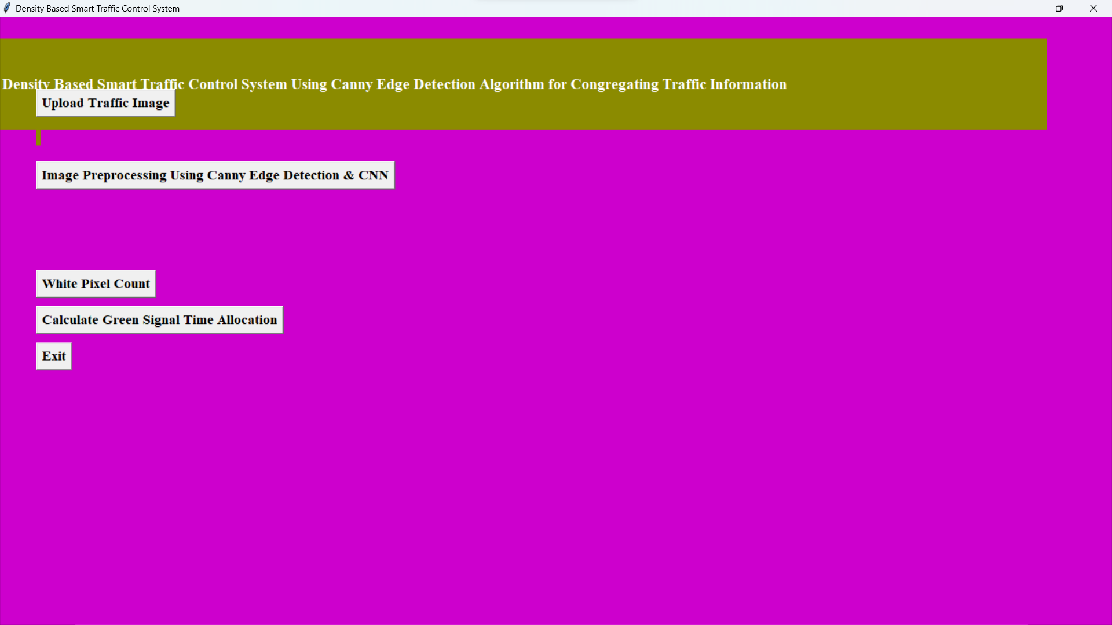
Design & Drawings of Prototype (Rough Sketches)

Slide 10
Conclusion
A smart traffic control system availing image processing as an instrument for measuring the density has been proposed.
Sample images of different traffic scenario have been attained. Upon completion of edge detection, the similarity between sample images with the reference image has been calculated.
Using this similarity, time allocation has been carried out for each individual image in accordance with the time allocation algorithm.
In addition, similarity in percentage and time allocation have been illustrated for each of the sample images using Python programming language.

Slide 11
References
Siddique, A. (2017). WB: Dhaka’s average traffic speed 7kmph. [online] Dhaka Tribune. Available at:
http://www.dhakatribune.com/bangladesh/dhaka/2017/07/19/dhakaaverage-traffic-speed-7-kmph/ [Accessed 25 Jul. 2017].
M. Sweet, “Traffic Congestion’s Economic Impacts: Evidence from US Metropolitan Regions,” Urban Studies, vol. 51, no. 10, pp. 2088–2110, Oct. 2013. Md. Munir Hasan, Gobinda Saha, Aminul Hoque and Md. Badruddoja Majumder, “Smart Traffic Control System with Application of Image Processing Techniques,”in 3rd International Conference on Informatics, Electronics & Vision, Dhaka, May 2014.
Vismay Pandit, Jinesh Doshi, Dhruv Mehta, Ashay Mhatre and Abhilash Janardhan, “Smart Traffic Control System Using Image Processing,”International Journal of Emerging Trends & Technology in Computer Science (IJETTCS), Vol. 3, Issue 1, January – February 2014.

Slide 12


